Slide 1
Sign Language Recognition System- A Mobile App
BASITH K P
21352011

Slide 2
Project overview
Sign language, as a different form of the communication language, is important to large groups of people in our society
But only less people know sign language and that makes barriers to dumb persons to efficiently interact with society.
Using Deep learning the system detect and classify the signs in the sign language
Making a mobile app using this deep learning model
The CNN model, Denset 121 is used here

Slide 3
OBJECTIVES
Predict sign language in real time using images.
Build a Sign Language model using an Action Detection powered by Denset121
Build a mobile app for the sign detection using flutter dart

Slide 4
ALGORITHM DEFINITION
Convolutional Neural Network:
ConvNets are multilayer artificial neural networks designed to handle 2D or 3D data as input.
A Convolutional Neural Network (ConvNet/CNN) is a Deep Learning system that can take an input picture and assign importance (learnable weights and biases) to various aspects/objects in the image, as well as differentiate between them.

Slide 5
DenseNet121
DenseNet-121 is a convolutional neural network (CNN) architecture that consists of 121 layers.
It is known for its dense connectivity pattern, where each layer is directly connected to every other layer in a feed-forward manner.
This design promotes better gradient flow, reduces vanishing gradients, and enhances feature reuse within the network.
DenseNet-121 has achieved state-of-the-art performance on various computer vision tasks, such as image classification, object detection, and image segmentation.
Its dense connectivity allows it to capture fine-grained features and improve model accuracy while efficiently utilizing memory and parameters.

Slide 6
Meadiapipe holistic
MediaPipe Holistic is an open-source framework developed by Google that combines various machine learning models to understand human perception in real-time. It enables applications such as body pose estimation, hand tracking, facial landmark detection, and segmentation. With MediaPipe Holistic, developers can create interactive experiences involving the human body, making it suitable for augmented reality, fitness tracking, and interactive gaming.

Slide 7
Proposed work
Sign language recognition requires efficient and robust data to design a highly accurate system that would be helpful for real-time users.
Here I have used the custom-built dataset to solve the sign detection and classification problem.
The data flows at different stages for sign language recognition viz. Dataset, Image Acquisition, Data Pre-processing, Feature Extraction, Sign Classification.
API of deep learning model is made by Flask to connect with mobile app
The model of this sign classification will use on mobile app making

Slide 8

Work Flow
Data collection and pre-processing
Model training and optimisation
Model Export
(Flask API)
Mobile APP Development

Slide 9
Data collection and pre-processing
Challenges in Data Collection:
Lack of Standard Datasets: The unavailability of standard datasets for Indian Sign Language posed a challenge.
Manual Dataset Construction: To overcome this, we manually captured images using a webcam, considering 42 different signs.
7000+ images collected as data set

Slide 10
Data Collection Process:
Image Capture: Using a webcam, we captured images of various sign gestures.
Image Format: The captured images were converted to the BGR format.
Key Point Extraction: MediaPipe Holistic model helped extract key points from the images.
Holistic Key Point Storage: Only the holistic key points were saved as ".jpg" files.
Uniformity of Scale: All images were resized to the same dimensions.
Color Space Conversion: If the images were in BGR format, we converted them to RGB.

Slide 11
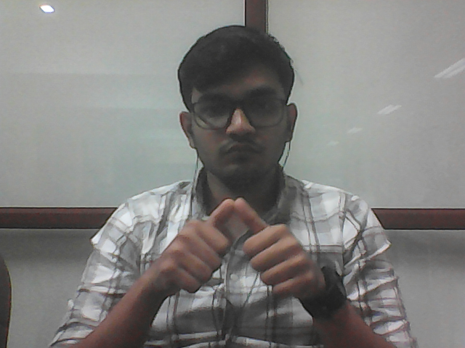
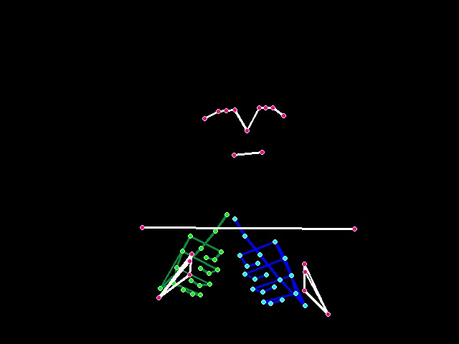

Slide 12
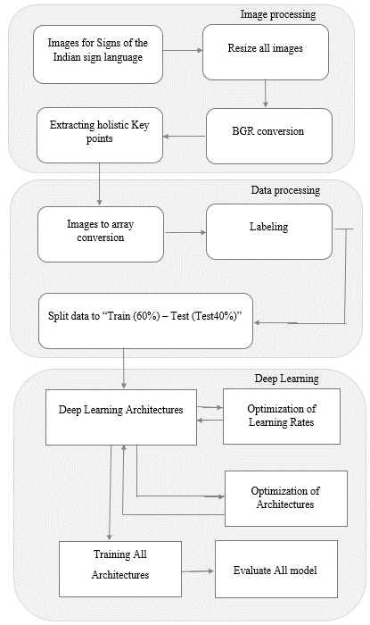
Model training and optimisation

Slide 13
Experiment and results
The system is trained to recognize 42 signs.
The total epochs are 50.
Densenet-121 performance we have observed an overall accuracy of 98.651%

Slide 14
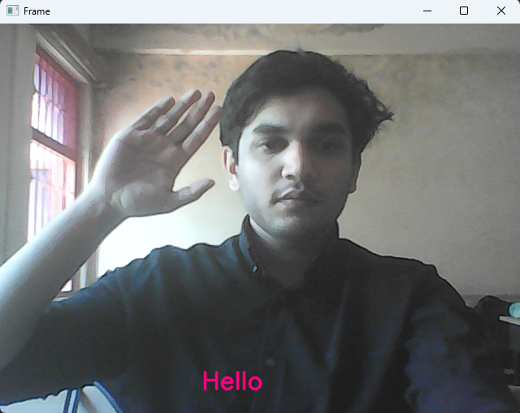
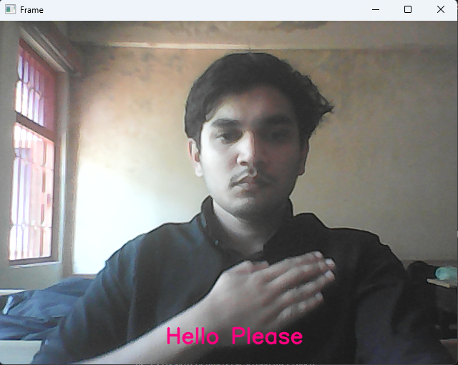
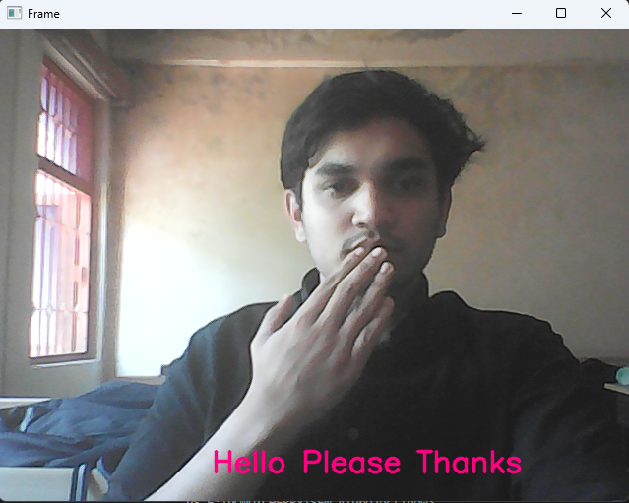
Real time testing on OpenCV

Slide 15
API-Flask-Mobile App
Backend API Framework - Flask:
Handles communication between the mobile app and the server.
Provides endpoints for capturing sign language gestures, recognizing them, and returning translated results.
Frontend Framework - Flutter:
Used to develop the mobile app interface.
Integrates smoothly with the Flask backend API.
Communication between Mobile App and Server:
Mobile app interacts with the Flask backend API.
Sends sign language gestures to the server for recognition and translation.
Receives the translated results from the server and displays them in the mobile app

Slide 16
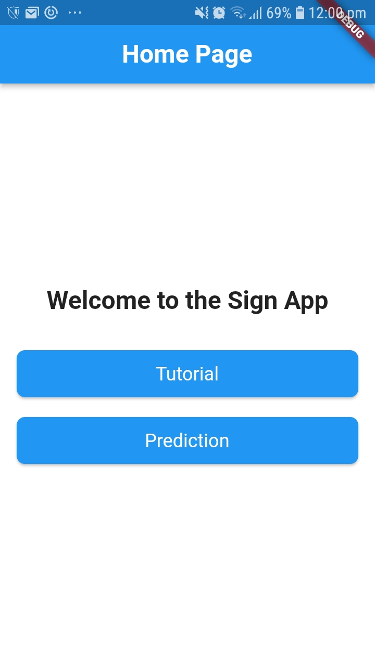
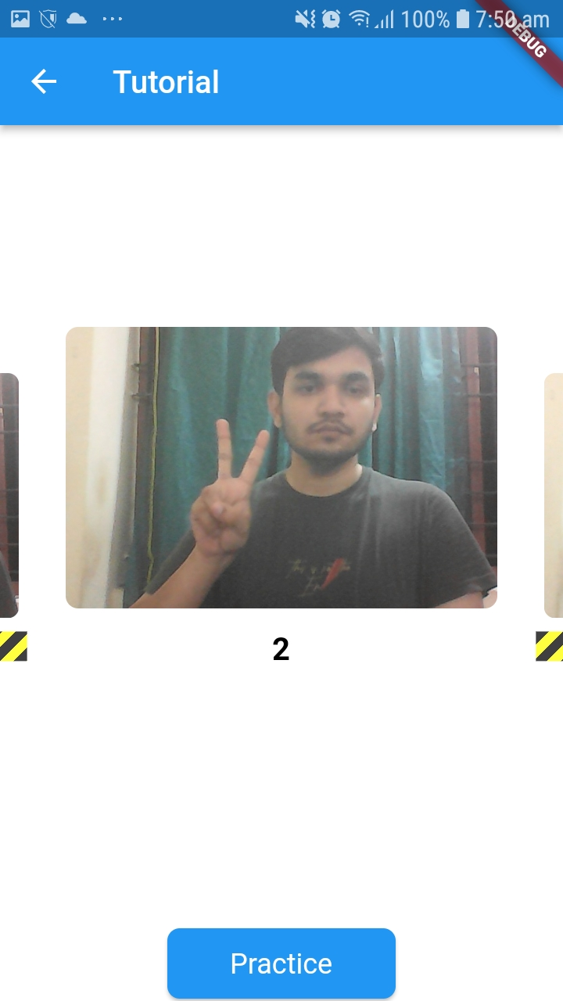
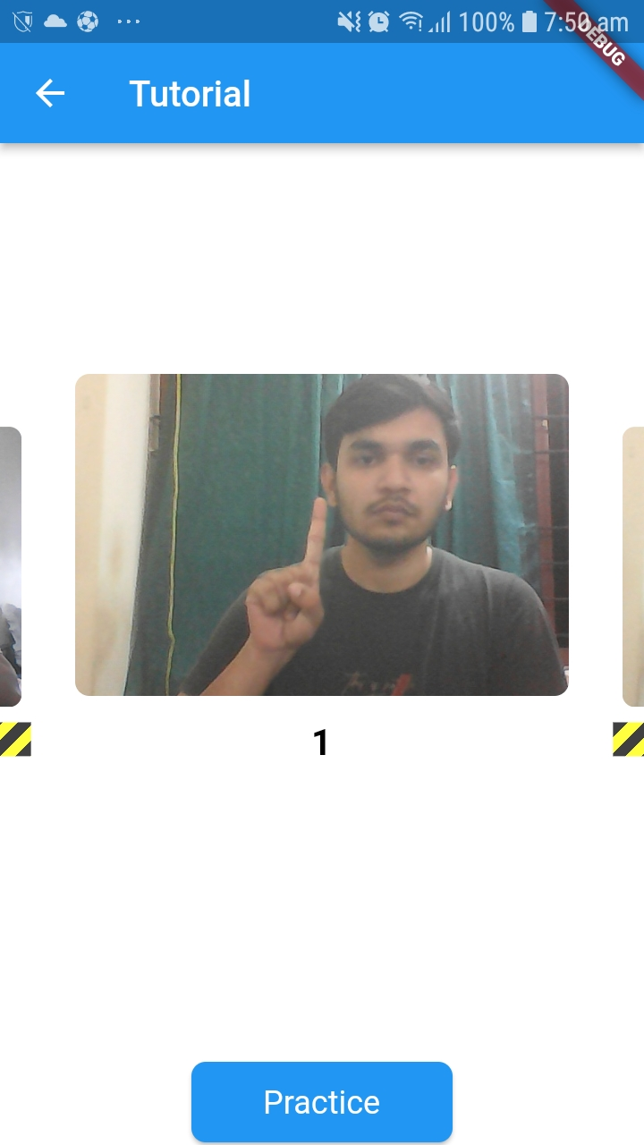
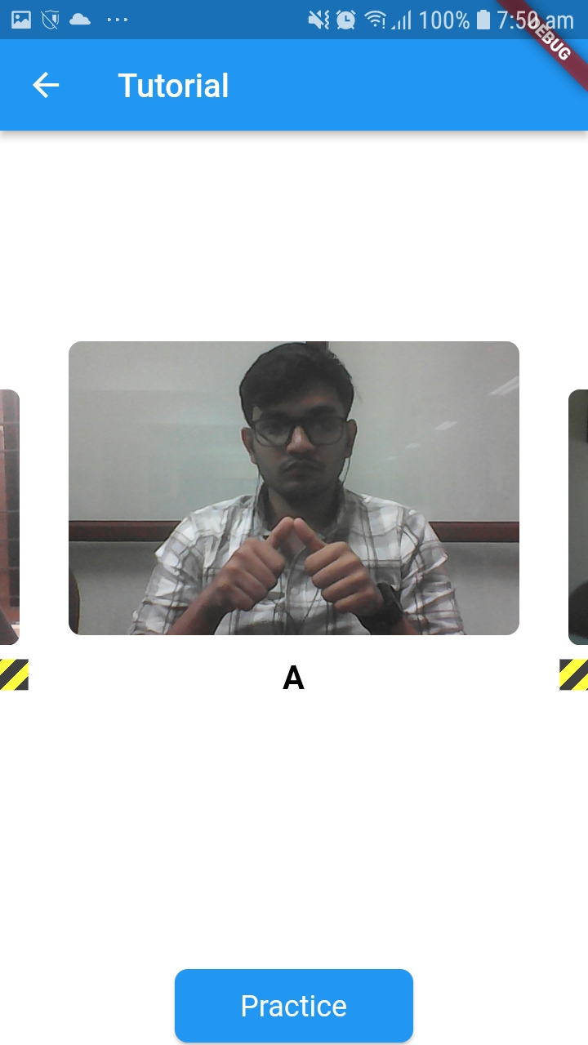

Slide 17
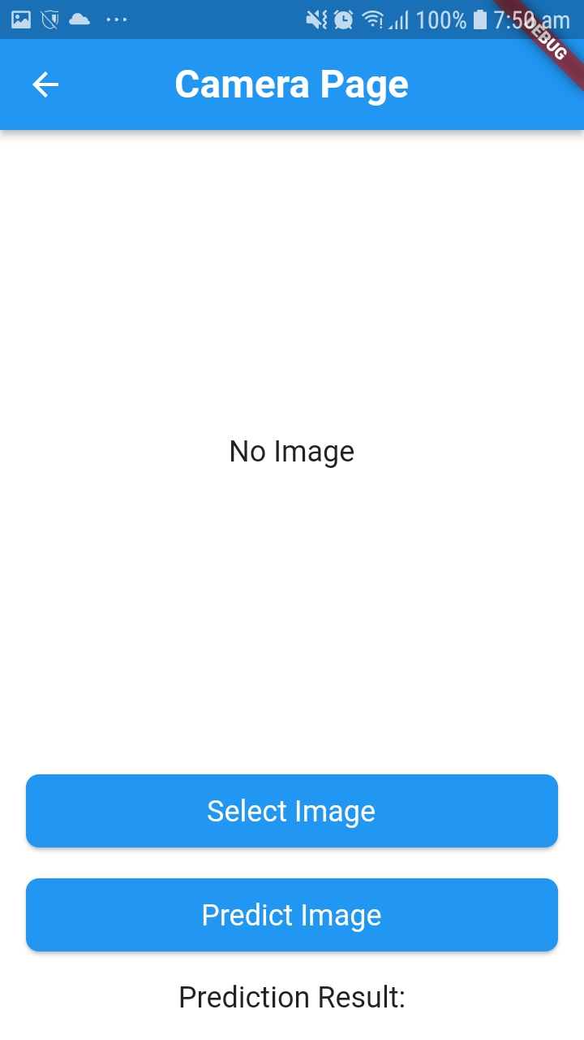
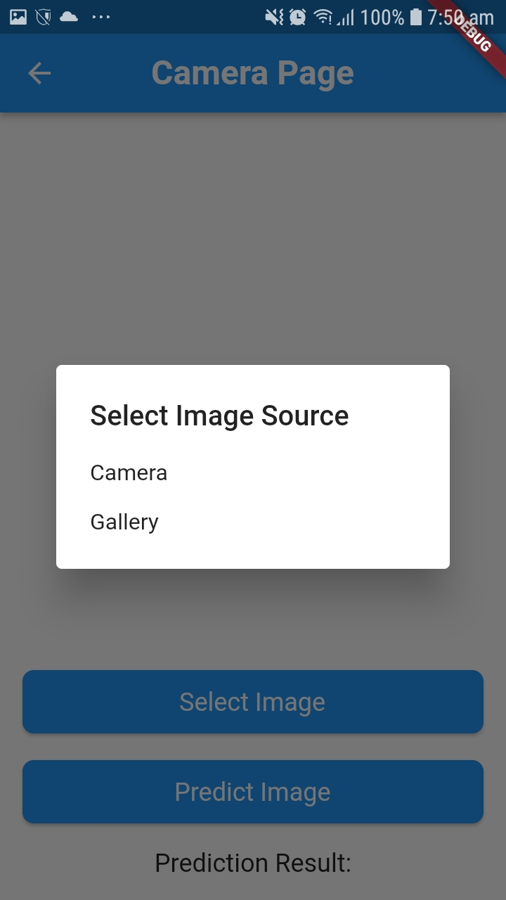
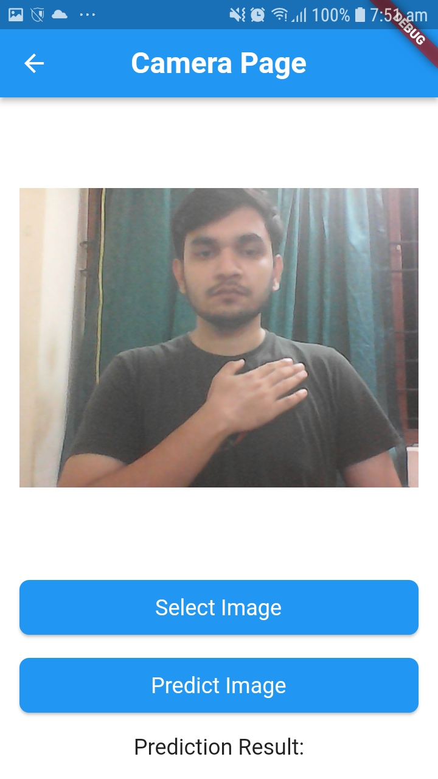

Slide 18
THANK YOU

